Slide 1
Sentiment Analysis using Logistic Regression
BY:
MEGHANA.R
25PG00174

Slide 2
Introduction
Sentiment Analysis is used to identify opinions in text
It classifies text as Positive or Negative
Widely used in reviews, social media, feedback systems
Sentiment Analysis is a technique in Natural Language Processing (NLP)
Used to identify emotions/opinions in text data
Classifies text into:
Positive
Negative
Helps organizations understand customer feedback
Commonly used in:
Product reviews
Social media analysis
Customer support systems

Slide 3
Problem Statement
Huge amount of unstructured text data is generated daily
Manual analysis is:
Time-consuming
Error-prone
Difficult to understand sentiment in large datasets
Traditional systems fail to capture contextual meaning
Need for automated, accurate sentiment classification system

Slide 4
Existing System
Uses traditional Machine Learning algorithms:
Naive Bayes
Support Vector Machines (SVM)
Converts text into numerical form using basic methods
Treats each word independently
Works well for simple sentences
Used in early research papers

Slide 5
Limitations of Existing System
Cannot understand context or word relationships
Fails in handling negation:
Example: “not good”
Ignores word order in sentences
Lower prediction accuracy
Sensitive to small dataset size
Limited ability to generalize

Slide 6
Proposed System
Uses Logistic Regression algorithm
Applies TF-IDF for feature extraction
Uses N-grams to capture word combinations
Improves handling of phrases like “not good”
Provides better classification accuracy
Simple, efficient, and easy to implement

Slide 7
Methodology
Data Collection
Created dataset with positive & negative sentences
Data Preprocessing
Cleaned text data
Feature Extraction
Applied TF-IDF
Model Training
Used Logistic Regression
Prediction
Classified input as positive or negative
Evaluation
Checked output accuracy

Slide 8
Implementation
Implemented using Python in Google Colab
Libraries used:
pandas (data handling)
scikit-learn (ML models)
Steps performed:
Dataset creation
Vectorization
Model training
Prediction
Code executed successfully without errors

Slide 9
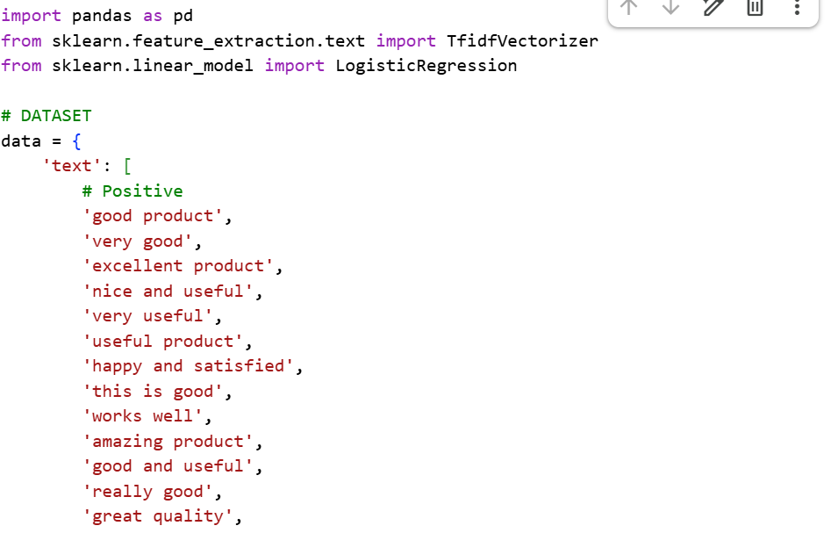
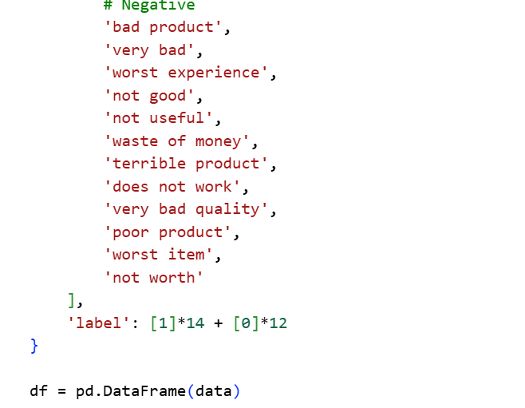
Results :

Slide 10
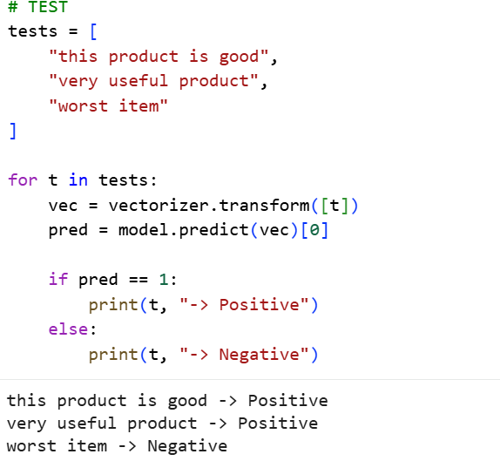
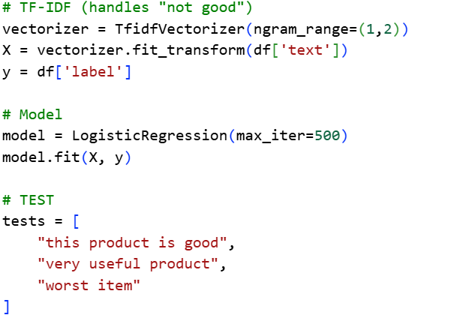
Points:
Model successfully classifies sentiment Correctly predicts:
Positive sentences
Negative sentences
Handles negation using n-grams
Output is consistent and reliable
Demonstrates improvement over basic models

Slide 11
Conclusion & Future Work
Conclusion:
Logistic Regression is effective for sentiment analysis
TF-IDF improves feature representation
N-grams help capture contextual meaning
Model provides accurate and stable results
Future Work:
Use larger real-world datasets (IMDb, Twitter)
Apply Deep Learning models (LSTM, RNN)
Improve handling of complex sentences
Build real-time sentiment analysis system

